Slide 1
Portfolio Analysis Model
By Daulton Kendall and Justin Wong

Slide 2
Goal of our Model
This model aims to provide a free, accessible tool for analyzing stock portfolios by retrieving, visualizing, and comparing key financial and performance data. By leveling the playing field for everyday investors, it empowers smarter, data-driven decisions without the need for expensive financial platforms.

Slide 3
01
Data Retrieval

Slide 4
Data Gathering Process
Source:
Data is collected using Python library yfinance, which interfaces with Yahoo Finance's publicly available endpoints.
Data Types Collected:
Historical Price Data – daily adjusted close prices
Corporate Actions – dividends, splits
Financial Statements – income, balance sheet, cash flow (annual & quarterly)
Shareholder Information – major and institutional holders
Output Format:
Data is exported to .csv files for traceability and ease of analysis
Data used for visualizations, regional classification, and portfolio metrics

Slide 5
02
Dashboard

Slide 6

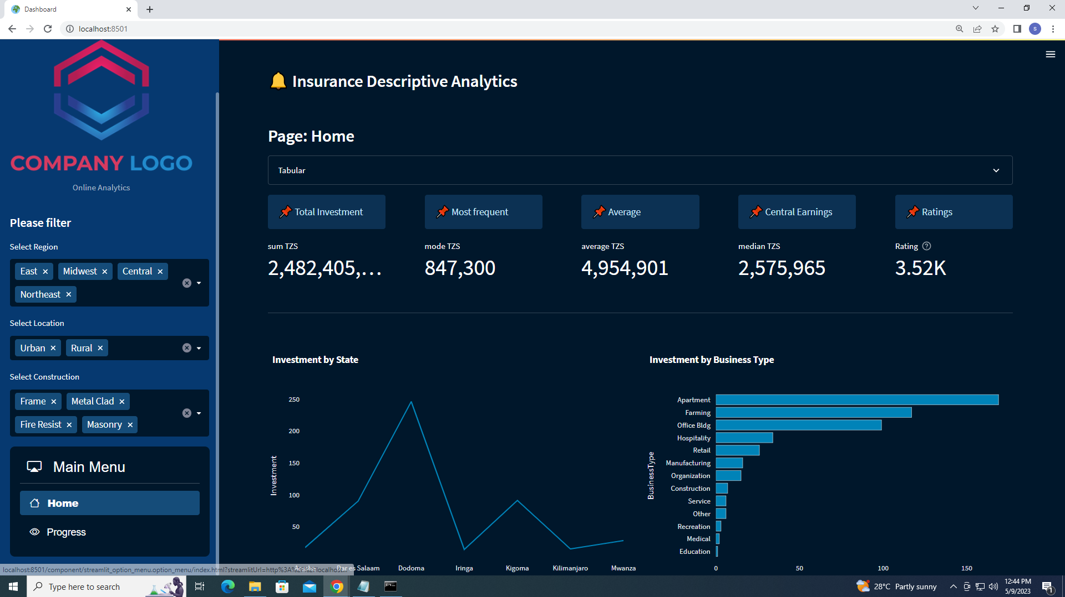
Streamlit
What is Streamlit?
An open-source Python framework for building interactive web apps quickly and easily.
Designed specifically for data scientists and analysts — no need for frontend development.
How it Enhances Portfolio Analysis
Allows users to customize their view: choose which stocks, regions, or metrics to analyze.
Delivers instant feedback: visualize performance, risk, and key ratios interactively.
Makes the model accessible and intuitive to non-technical users.

Slide 7
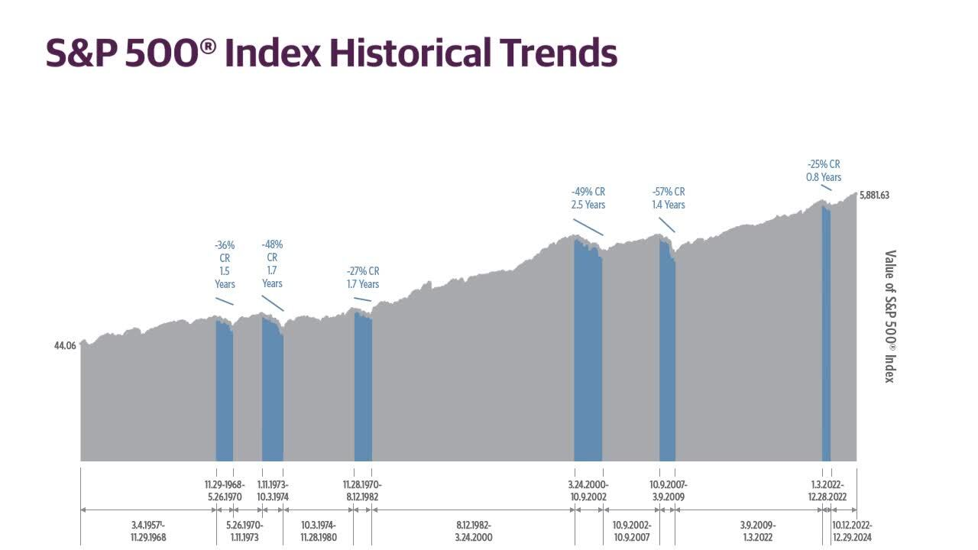
Benchmarking Against SPY (S&P 500 ETF)
Why SPY?
Represents broad market performance — a natural benchmark for evaluating portfolio return and risk.
Highly liquid and widely tracked by institutional and retail investors.
Interpretation
Outperformance: Does the portfolio generate a higher return than SPY with acceptable risk?
Diversification: How correlated are assets to SPY? Are they adding real value?
Risk Efficiency: A higher Sharpe ratio than SPY indicates better risk-adjusted performance.

Slide 8
Diversification of Portfolio
Region Classification:
Based on exchange info (e.g., NYSE, LSE, TSE)
Categorized as American, European, Asian, Other
Industry Classification:
Pulled from yfinance sector metadata
e.g., Technology, Healthcare, Financials, Consumer Goods
Streamlit Integration
Pie chart: % allocation by region
Bar chart: % allocation by industry
Table view of stocks by group
15%
40%
20%
25%
United States
European
Asian
Other

Slide 9
03
Implementing Machine Learning

Slide 10
Return Prediction Model
Goal: Predict short-term stock returns to support smarter portfolio decisions.
Features:
Price-based: daily returns, moving averages, volatility, RSI
fundamentals (P/E, revenue growth), sector, region
Dashboard Output:
Show predicted return for each stock
Rank stocks by expected return
Highlight confidence or risk level
Value:
Adds predictive insight to the dashboard
Helps users optimize allocations based on forward-looking signals

Slide 11
04
Next Steps

Slide 12
Next Steps
Dashboard
Expand Coverage
Build Return Model
Build out an interactive Streamlit dashboard
Include more International exchanges and sectors
Create a returns model using Linear Regression, XGBoost, or LSTM(time series)

Slide 13
Thank You

